Slide 1
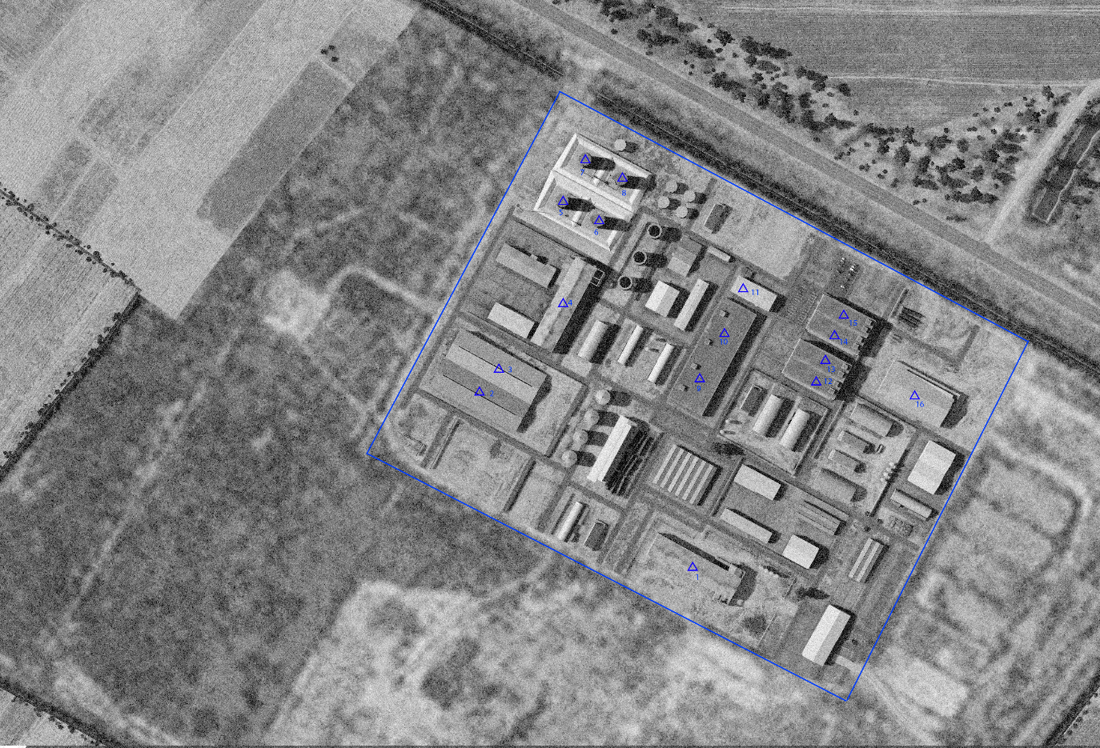

SYTGT017 JIRAH AMMUNITION FACTORY
N
17
DESIRED POINT of IMPACT:
DPI 16 - N36 01.365 E 37 58.371 / 1177ft / 2000lb Bomb
DPI 15 - N36 01.406 E 37 58.318 / 1177ft / 2000lb Bomb
DPI 14 - N36 01.395 E 37 58.313 / 1177ft / 2000lb Bomb
DPI 13 - N36 01.380 E 37 58.303 / 1185ft / 2000lb Bomb
DPI 12 - N36 01.371 E 37 58.297 / 1185ft / 2000lb Bomb
DPI 11 - N36 01.419 E 37 58.257 / 1190ft / 2000lb Bomb
DPI 10 - N36 01.362 E 37 58.234 / 1194ft / 2000lb Bomb
DPI 9 - N36 01.369 E 37 58.220 / 1182ft / 2000lb Bomb
DPI 8 - N36 01.481 E 37 58.164 / 1182ft / 500lb Bomb
DPI 7 - N36 01.492 E 37 58.139 / 1181ft / 500lb Bomb
DPI 6 - N36 01.458 E 37 58.149 / 1191ft / 500lb Bomb
DPI 5 - N36 01.468 E 37 58.123 / 1188ft / 2000lb Bomb
DPI 4 - N36 01.405 E 37 58.081 / 1202ft / 2000lb Bomb
DPI 3 - N36 01.375 E 37 58.081 / 1202ft / 2000lb Bomb
DPI 2 - N36 01.358 E 37 58.069 / 1183ft / 2000lb Bomb
DPI 1 - N36 01.263 E 37 58.215 / 1183ft / 2000lb Bomb
No CDC concerns.

Slide 2
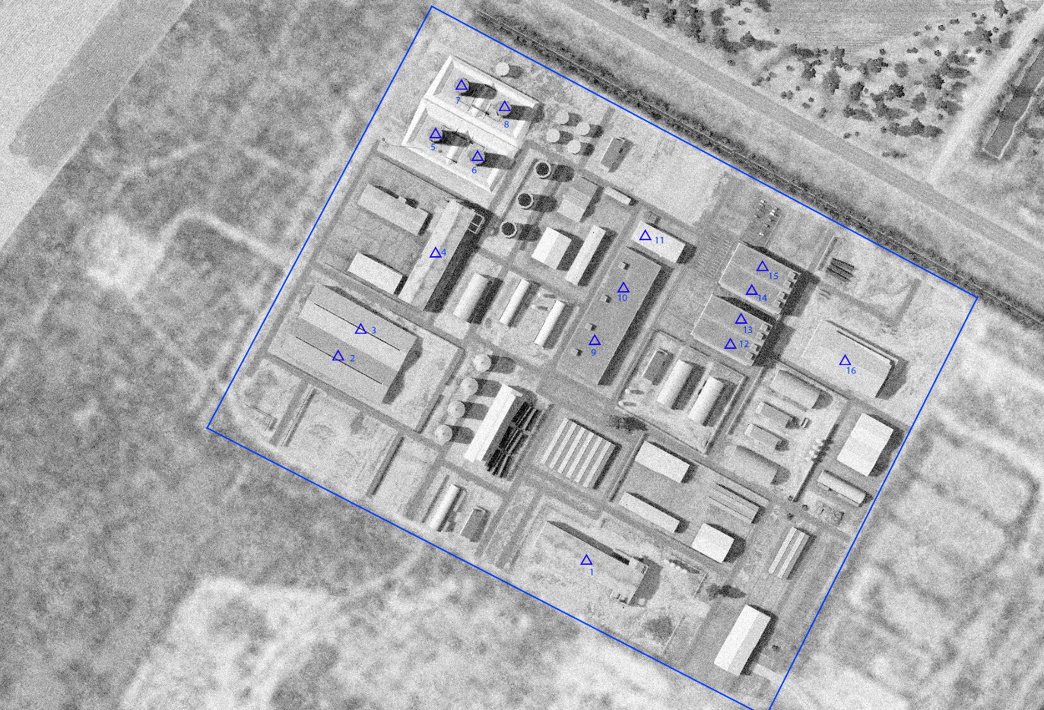
OPARTGT017 JIRAH AMMUNITION FACTORY
N
17
DESIRED POINT of IMPACT:
DPI 16 - N36 01.365 E 37 58.371 / 1177ft / 2000lb Bomb
DPI 15 - N36 01.406 E 37 58.318 / 1177ft / 2000lb Bomb
DPI 14 - N36 01.395 E 37 58.313 / 1177ft / 2000lb Bomb
DPI 13 - N36 01.380 E 37 58.303 / 1185ft / 2000lb Bomb
DPI 12 - N36 01.371 E 37 58.297 / 1185ft / 2000lb Bomb
DPI 11 - N36 01.419 E 37 58.257 / 1190ft / 2000lb Bomb
DPI 10 - N36 01.362 E 37 58.234 / 1194ft / 2000lb Bomb
DPI 9 - N36 01.369 E 37 58.220 / 1182ft / 2000lb Bomb
DPI 8 - N36 01.481 E 37 58.164 / 1182ft / 500lb Bomb
DPI 7 - N36 01.492 E 37 58.139 / 1181ft / 500lb Bomb
DPI 6 - N36 01.458 E 37 58.149 / 1191ft / 500lb Bomb
DPI 5 - N36 01.468 E 37 58.123 / 1188ft / 2000lb Bomb
DPI 4 - N36 01.405 E 37 58.081 / 1202ft / 2000lb Bomb
DPI 3 - N36 01.375 E 37 58.081 / 1202ft / 2000lb Bomb
DPI 2 - N36 01.358 E 37 58.069 / 1183ft / 2000lb Bomb
DPI 1 - N36 01.263 E 37 58.215 / 1183ft / 2000lb Bomb
No CDC concerns.

